Slide 1

https://share.gemini.google/MeDtFS6jJI1e
J.A.R.V.I.S.
An Advanced Python-Powered Virtual Assistant & Local AI System
Developed by Arpit Tripathi

Slide 2


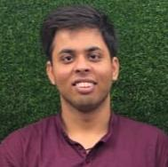

J.A.R.V.I.S.
Arpit Tripathi
CSE B.Tech III Year
Roll No: 2401220100075
Email: Arpittripathi4115@gmail.com
Shri Ramswaroop Memorial College of Engineering & Management

Slide 3

WHAT IS J.A.R.V.I.S?
J.A.R.V.I.S is a locally hosted, open-source personal automation bot designed to bridge the gap between human intent and machine execution.
Unlike cloud-dependent assistants, it operates securely on your desktop, leveraging local LLMs and computer vision to perform highly complex OS-level tasks without compromising your privacy.

Slide 4








TECHNOLOGY STACK
Core Engine
AI Brain
Computer Vision
Built entirely in Python. Utilizes speech_recognition for capturing audio logic and pyttsx3 (SAPI5) for low-latency, offline text-to-speech synthesis.
Powered by Ollama. Integrates advanced Large Language Models like Phi-3 and Llama-3 locally, enabling intelligent, conversational decision-making without API costs.
Leverages OpenCV and Google's MediaPipe for real-time hand tracking, alongside the LLaVA vision model for optical image processing and understanding.

Slide 5

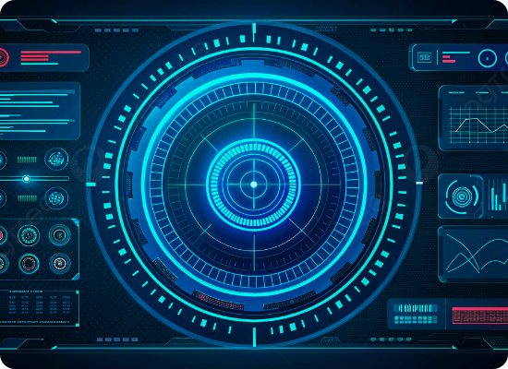
INTELLIGENT CAPABILITIES
■
Conversational Memory: Maintains context by logging interaction history in JSON, allowing for continuous, human-like dialogue across sessions.
■
Optical Processing: Integrates multimodal LLMs (LLaVA) via a custom '/look' command to visually analyze user-provided images.
■
Data Retrieval: Dynamically scrapes real-time data using BeautifulSoup, Wikipedia APIs, and WolframAlpha computational engines.
■
Persona Management: Operates strictly under a highly logical, mentor-like persona, offering precise technical guidance to the user.

Slide 6

SYSTEM & HEALTH MANAGEMENT
OS Automation Module
Health Command Center
J.A.R.V.I.S seamlessly handles system-level operations. It can dynamically adjust screen brightness, execute speed tests, take screenshots, and manage application lifecycles (opening/force-killing browsers, IDEs, and media players).
Designed for prolonged coding sessions, this module calculates BMI, analyzes blood pressure inputs, and computes optimal daily water intake.
It features a live lung capacity breath-hold test, heart rate tracking, and enforces the 20-20-20 eye strain rule to prioritize developer wellness.
It also monitors battery percentages and CPU utilization in real-time, issuing warnings during critical power states.

Slide 7

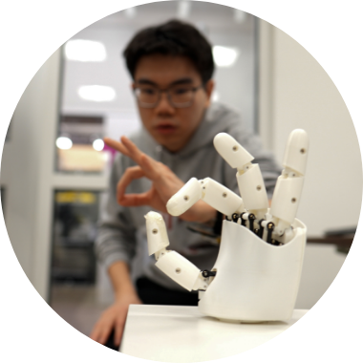
KINETIC GESTURE CONTROL
Touchless Interaction
The visual control interface transforms how the user interacts with the machine. Using a webcam, J.A.R.V.I.S processes RGB frames through MediaPipe's hand landmark detection models.
By calculating the mathematical hypotenuse between the thumb tip (Landmark 4) and index finger tip (Landmark 8), it maps physical distance to system master volume levels in real-time using `pycaw`, offering a seamless, futuristic control mechanism.

Slide 8





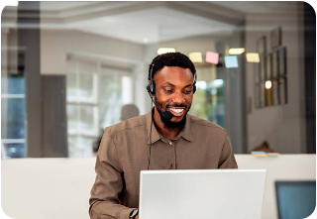


PRIMARY USE CASES
Developer Productivity
Hands-Free Accessibility
Daily Utility
Automates repetitive tasks, tracks late-night sleep cycles, manages window states, and reads PDF documentation aloud while the user codes.
Allows users to send WhatsApp messages, compose emails with attachments, and navigate the web entirely through voice commands.
Fetches real-time weather, locates IP-based geographical coordinates, solves complex math via WolframAlpha, and manages multimedia.

Slide 9
SYSTEM ADVANTAGES
Absolute Privacy & Security Because it runs local LLMs (Ollama) and offline speech engines (SAPI5), sensitive user data and ambient conversations never leave the local machine.
Low Latency Execution Bypassing cloud API round-trips for core system commands ensures immediate execution for tasks like minimizing windows or adjusting brightness.
High Extensibility The modular Python architecture allows rapid integration of new libraries, meaning J.A.R.V.I.S can be continuously taught new skills and custom scripts.
Intelligent Standby Mode To conserve system resources and microphone usage, the system features a silence-detection algorithm that automatically enters a low-power hibernation state.

Slide 10




EXECUTION PIPELINE
4. Execution
2. Recognition
The action is performed (API call, automation, or text generation) and the result is delivered via the offline SAPI5 TTS engine.
Google Speech API captures the audio stream, resolving the verbal input into a machine-readable text string.
1. Trigger
3. Processing
Background ambient noise monitoring detects wake words ("Jarvis", "Arpit this side") to break the standby loop.
The brain parses intent via regex for hardcoded OS commands, or routes complex queries to the local Ollama LLM node.

Slide 11
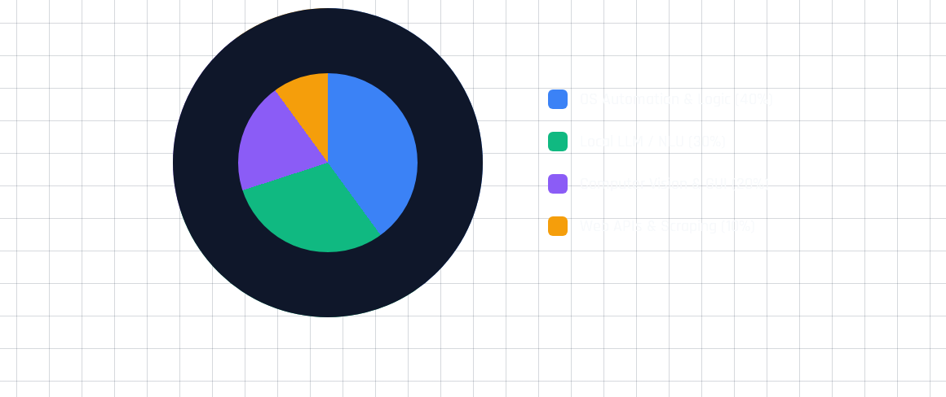
ARCHITECTURE DISTRIBUTION
The codebase is heavily weighted towards robust local execution, prioritizing OS-level automation and local Natural Language Understanding over external web dependencies.

Slide 12


Future Enhancements
The next iteration aims to integrate IoT protocols to command smart home devices locally, implement a robust Vector Database (like ChromaDB) for infinite contextual memory, and deploy asynchronous multi-threading to allow Jarvis to run background tasks while maintaining conversation.

Slide 13






IMAGE SOURCES
https://img.freepik.com/premium-photo/creative-circuit-brain-hologram-dark-background-ai-artificial-intelligence-machine-learning-neurology-concept-3d-rendering_670147-29142.jpg
Source: www.magnific.com
https://png.pngtree.com/background/20250519/original/pngtree-high-tech-digital-interface-design-with-glowing-blue-hud-graphics-in-picture-image_16540215.jpg
Source: pngtree.com
https://news.mit.edu/sites/default/files/images/202603/MIT-Hand-Tracker-01-press.jpg
Source: news.mit.edu
https://images.stockcake.com/public/0/a/e/0ae4f5cb-b728-48f1-9795-7abcd2ee6838_medium/coding-through-night-stockcake.jpg
Source: stockcake.com
https://media.istockphoto.com/id/2223442865/photo/sales-man-and-consulting-support-or-advice-with-headset-and-laptop.jpg?s=612x612&w=0&k=20&c=gF23PFsmsEBHVOQBRaznINj4wvC5ii4sm1S7hD4ALSs=
Source: www.istockphoto.com
https://cdn.mos.cms.futurecdn.net/8PBJwkj2W5Pxtx9yBgQVLD.jpg
Source: www.tomsguide.com

Slide 14

IMAGE SOURCES
https://d3njjcbhbojbot.cloudfront.net/api/utilities/v1/imageproxy/https://images.ctfassets.net/wp1lcwdav1p1/60KJr8r2gddr7nEMjJhpZO/7c4e17393b5c406982c6db62303e3d21/iStock-543677910.jpg?w=1500&h=680&q=60&fit=fill&f=faces&fm=jpg&fl=progressive&auto=format%2Ccompress&dpr=1&w=1000
Source: www.coursera.org

Slide 15
THANK YOU
For Your Time & Attention
J.A.R.V.I.S - Internship Project Presentation Developed by Arpit Tripathi

